Slide 1
PRESENTATION OF SOLVED CHALLENGE
Presented by Samuel NSENGIYUMVA

Slide 2
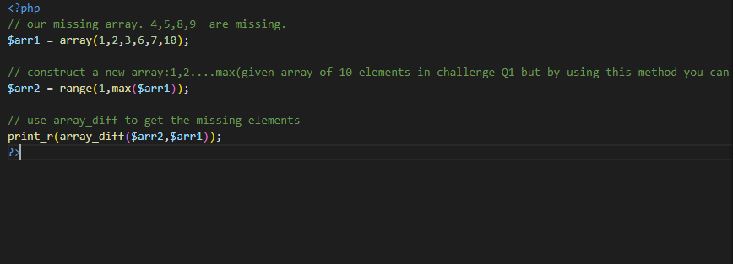
CHALLENGE 1
Question
Write a PHP program to find the missing number/numbers from an array of 10 elements and display the missing number/numbers
Input: 1,2,3,6,7
Answer

Slide 3
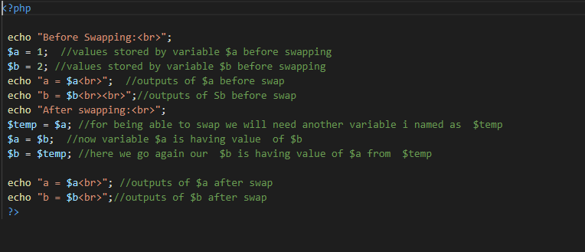
CHALLENGE 2
Question
Write a PHP program that swaps the value of one variable and put it in another variable
Answer

Slide 4
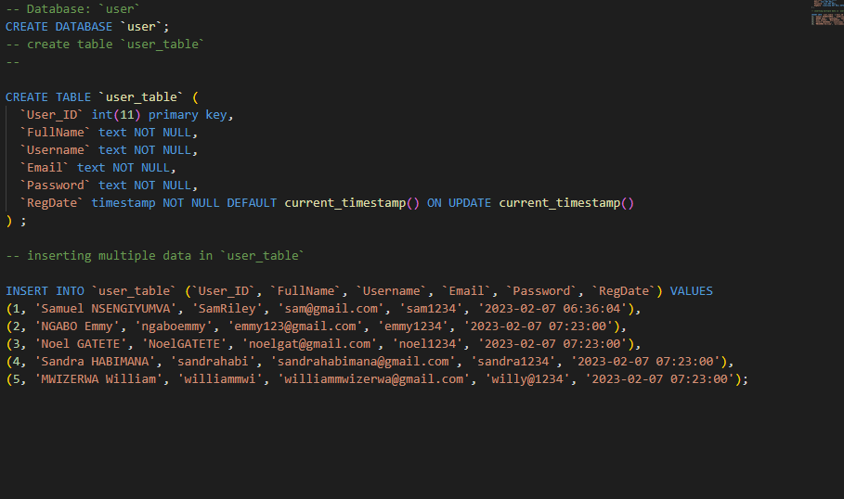
CHALLENGE 3
Question: Assuming you have been given a set of user information data to insert in the database write a MySQL query to create the database and table then insert the use information in the database
Answer

Slide 5
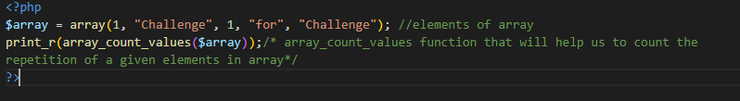
CHALLENGE 4
Question: Write a PHP program that counts the number of repetition of an element inside an array
Answer:

Slide 6
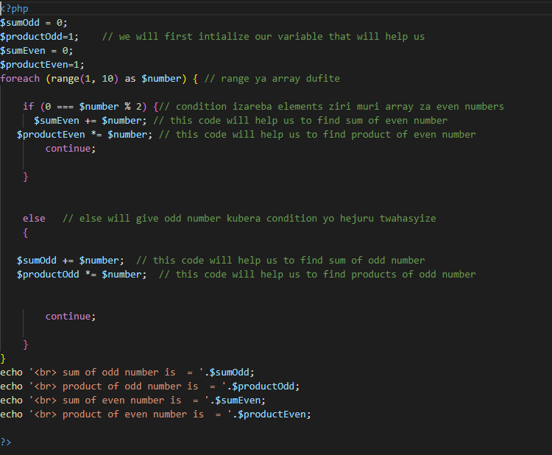
CHALLENGE 5
Question: Write a PHP program that allow the user to provide a list of numbers and then the program calculate the sum and product of even numbers and odd numbers and display the result to the user
Answer

Slide 7
END OF CHALLENGE
Thanks for your consideration and time
Samuel NSENGIYUMVA

